Slide 1
Network visualization and automation
Network visualization and automation
EuroPython 2017 - Rimini
Antoine Fourmy
EuroPython 2017

Slide 2
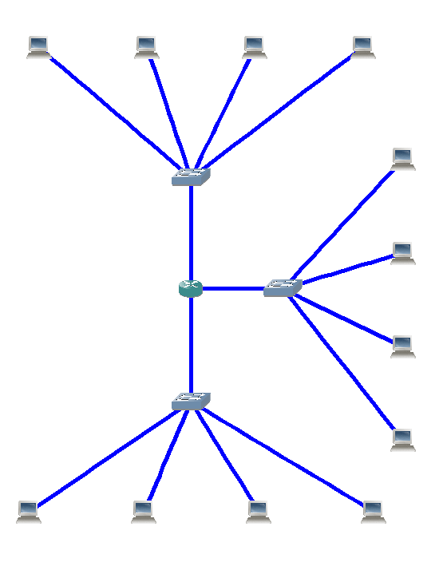
Telecommunication network :
Networking devices
Transmission links

Slide 3



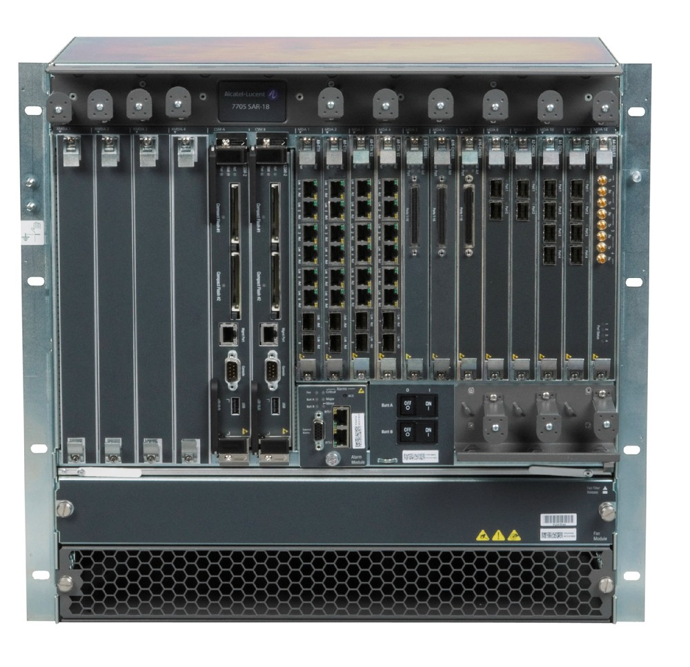
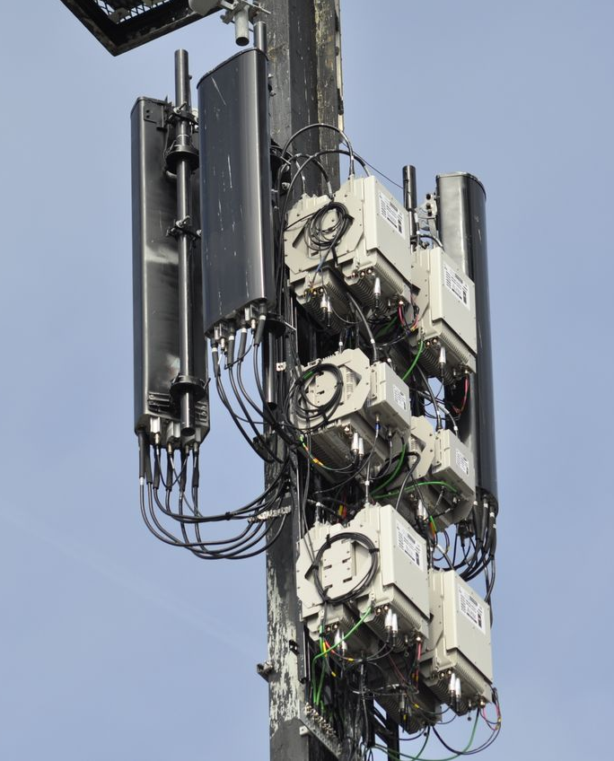
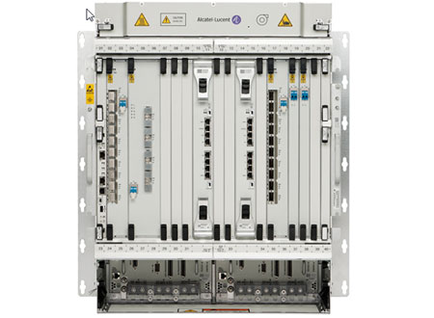
Nokia 7705 SAR
Nokia 1830 PSS
Nokia antenna
Router
Optical switch
Antenna

Slide 4

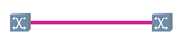
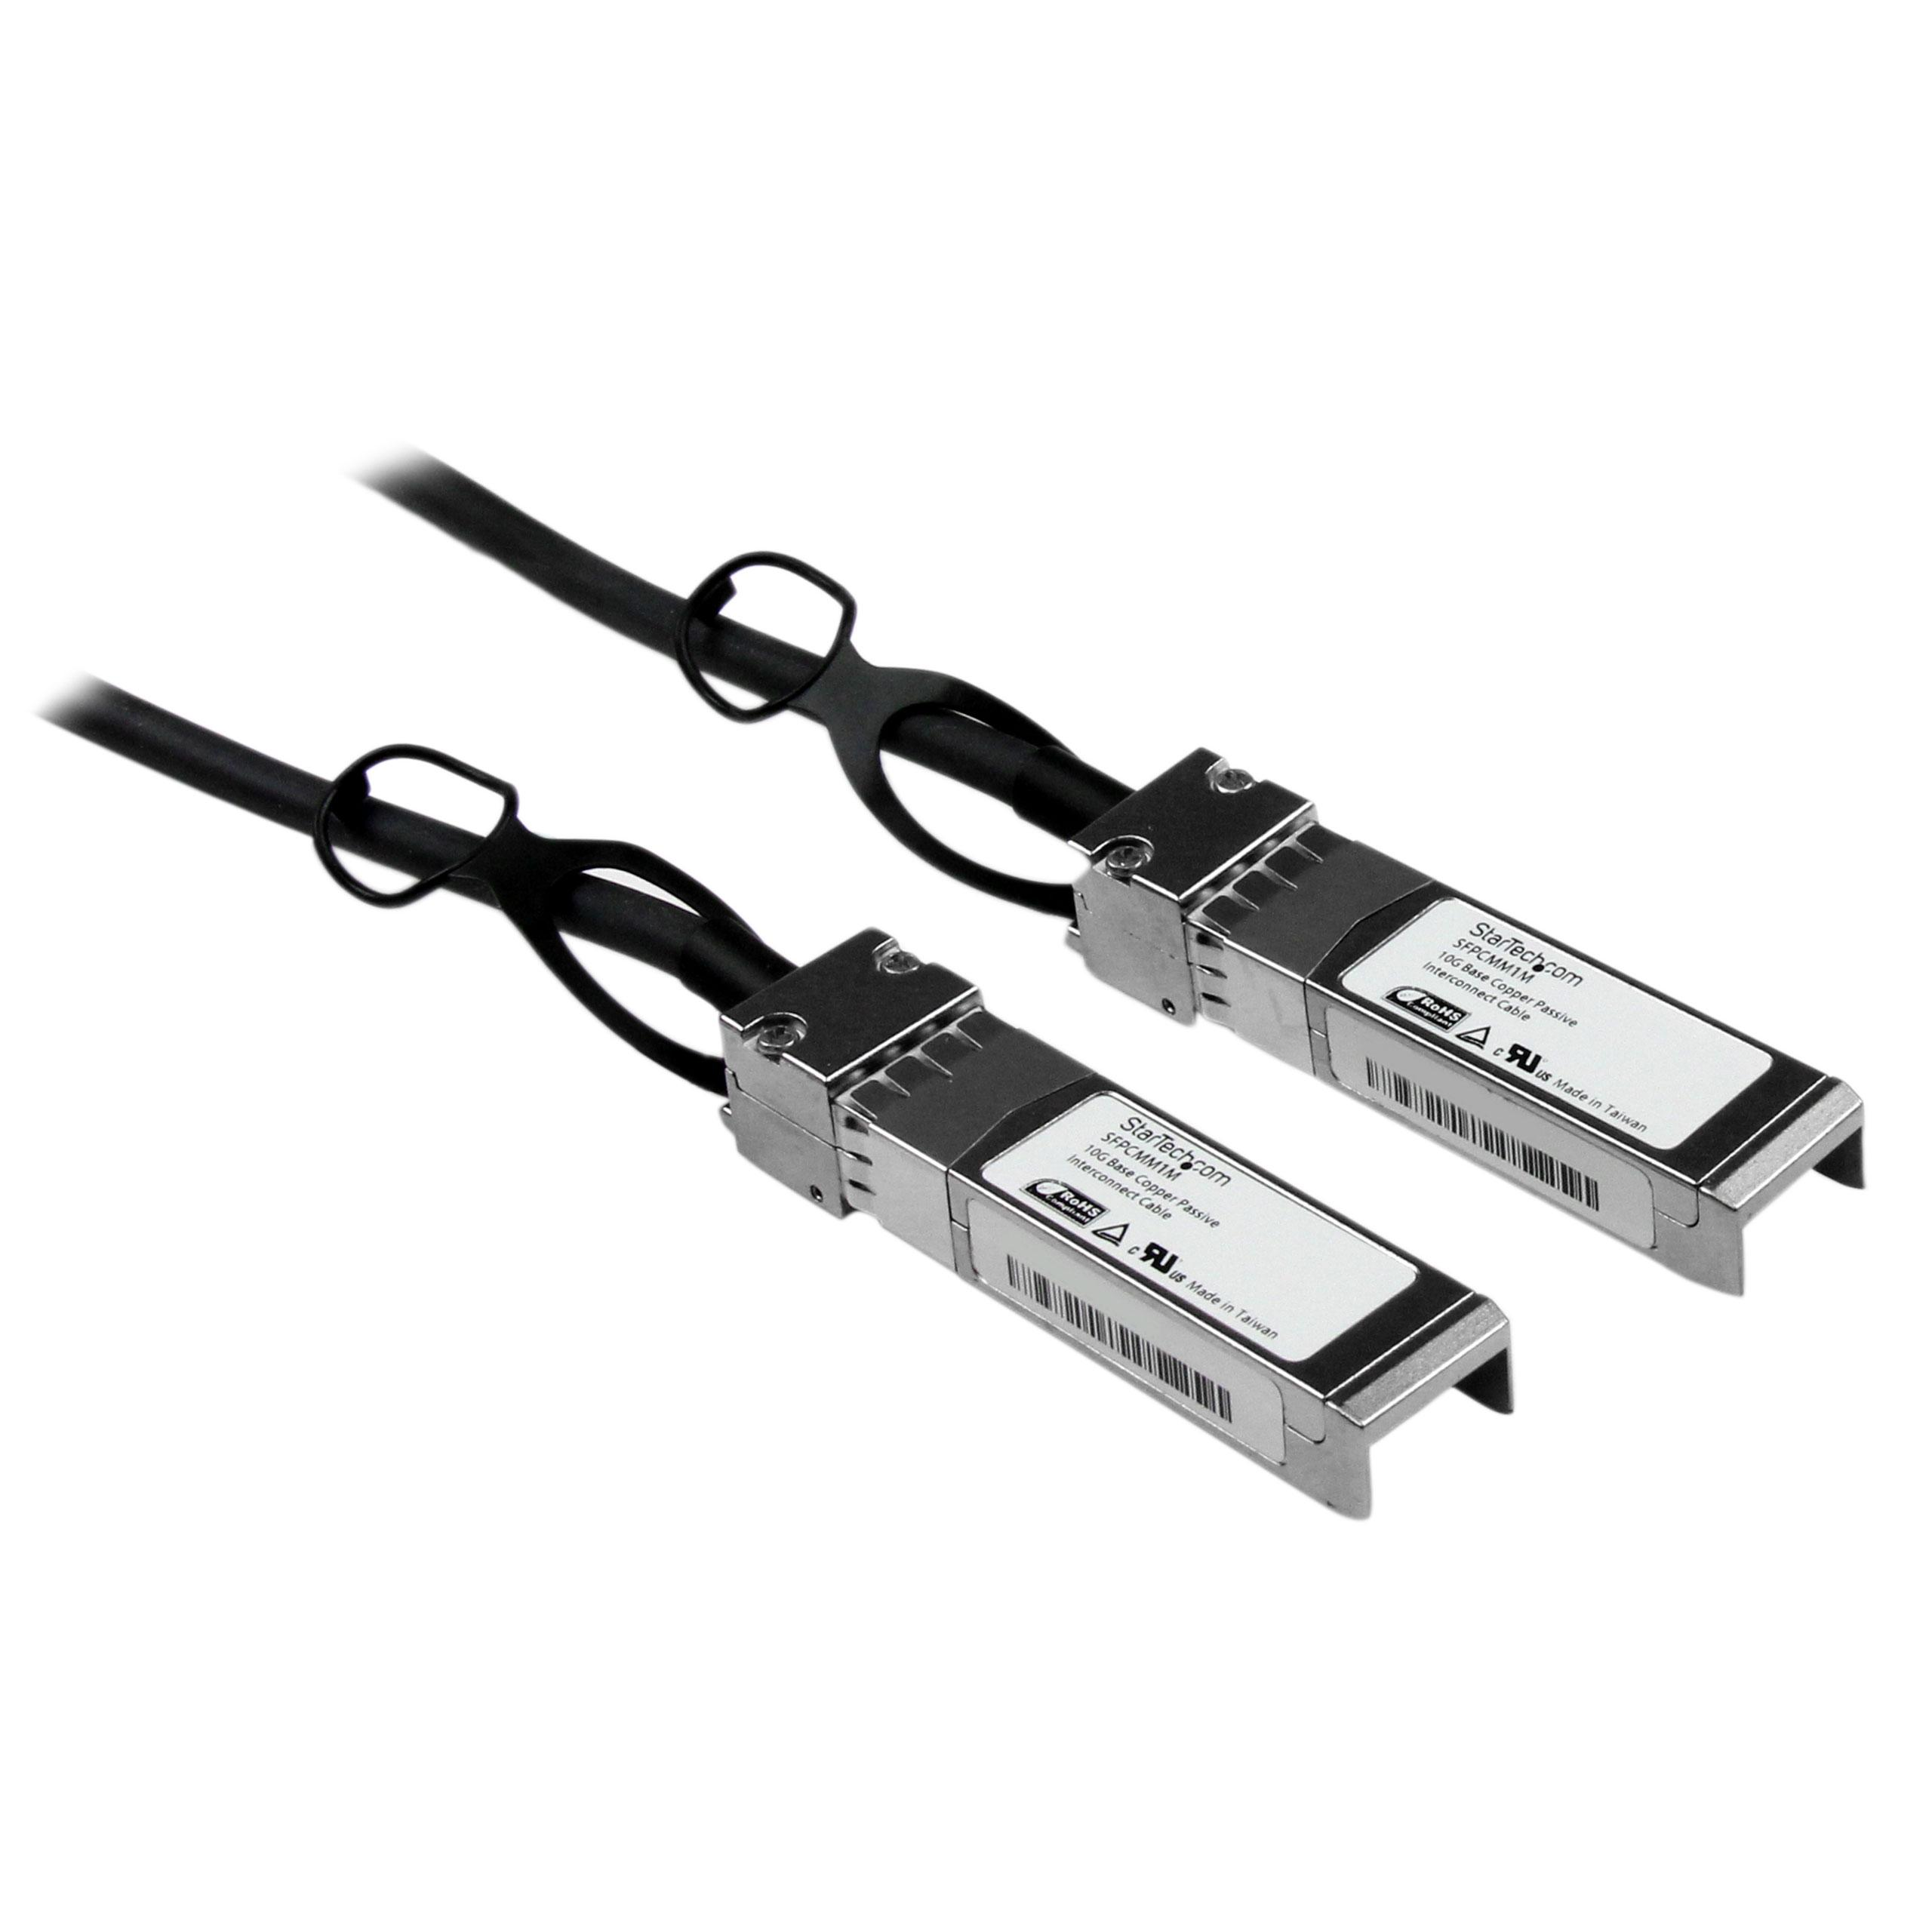
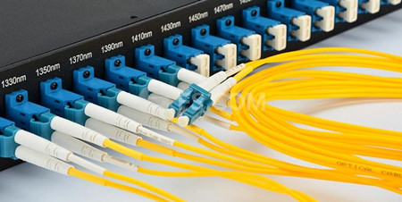
Ethernet (10G)
Optical fiber

Slide 5
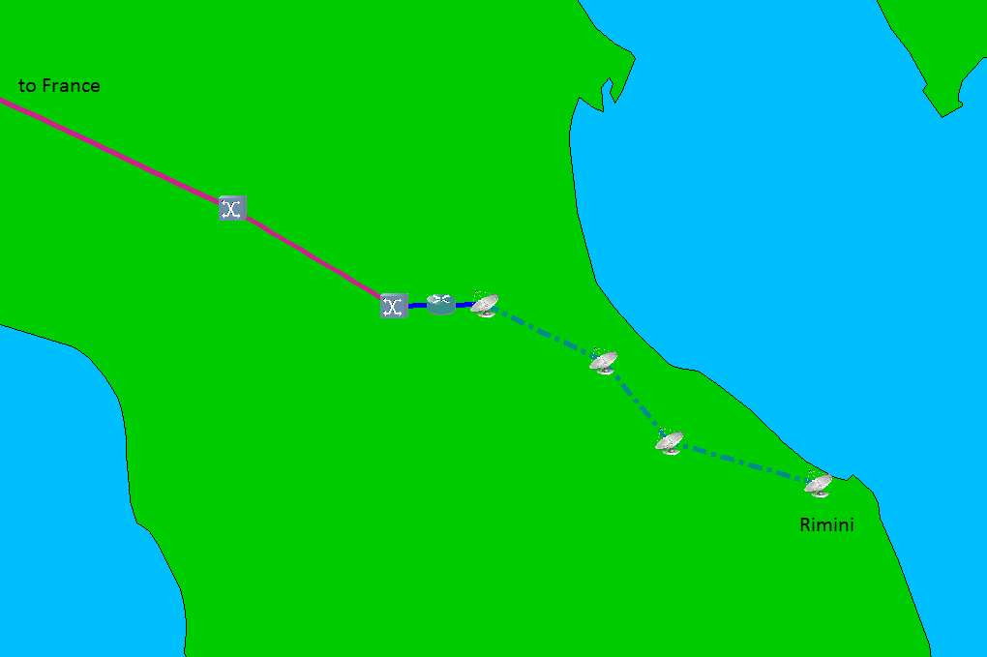
Forwarding decision
Microwave transmission
Electrical – Optical conversion
+
Wavelength multiplexing (WDM)

Slide 6
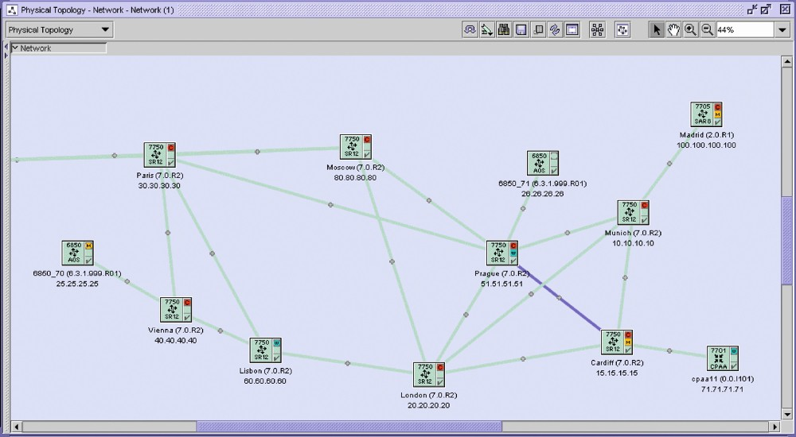
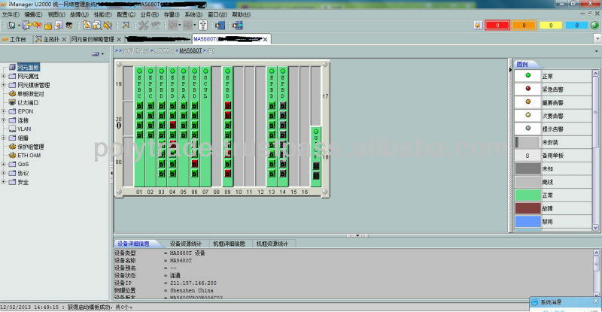

5620 SAM (Nokia)
Network Management System (NMS) are provided by equipment manufacturers :
Network visualization
Network inventory
Network provisioning
Network supervision
Network automation (not always)
U2000 (Huawei)
OneControl (Ciena)

Slide 7
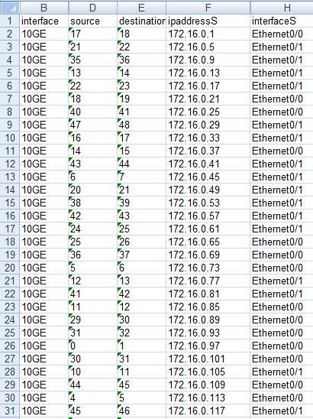
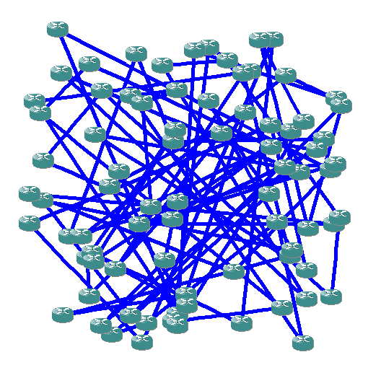
Network topology
Drawing of the associated network

Slide 8
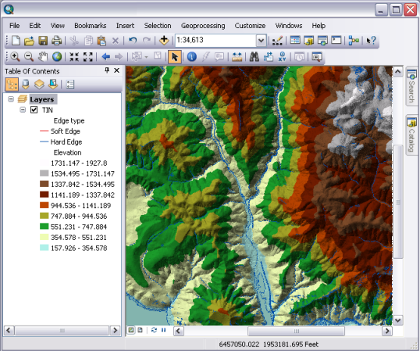
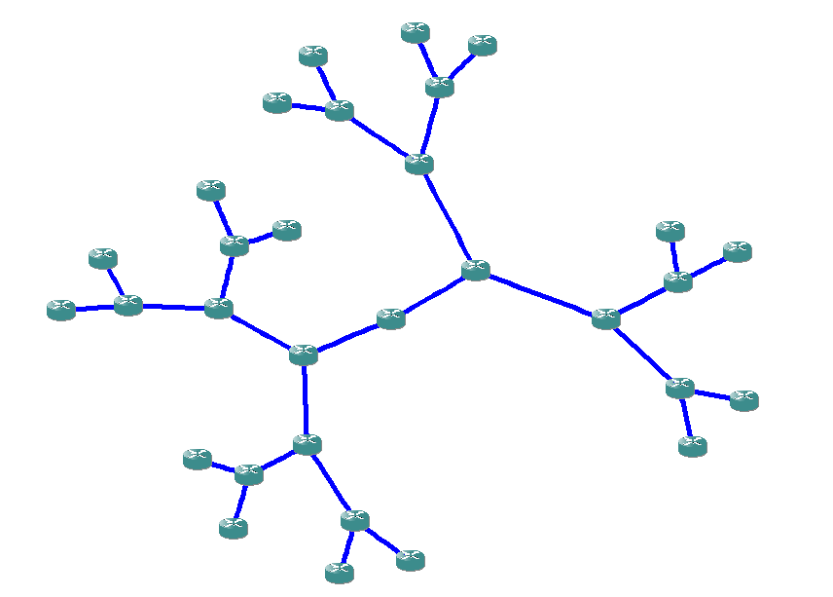
GPS coordinates
Drawing algorithm

Slide 9

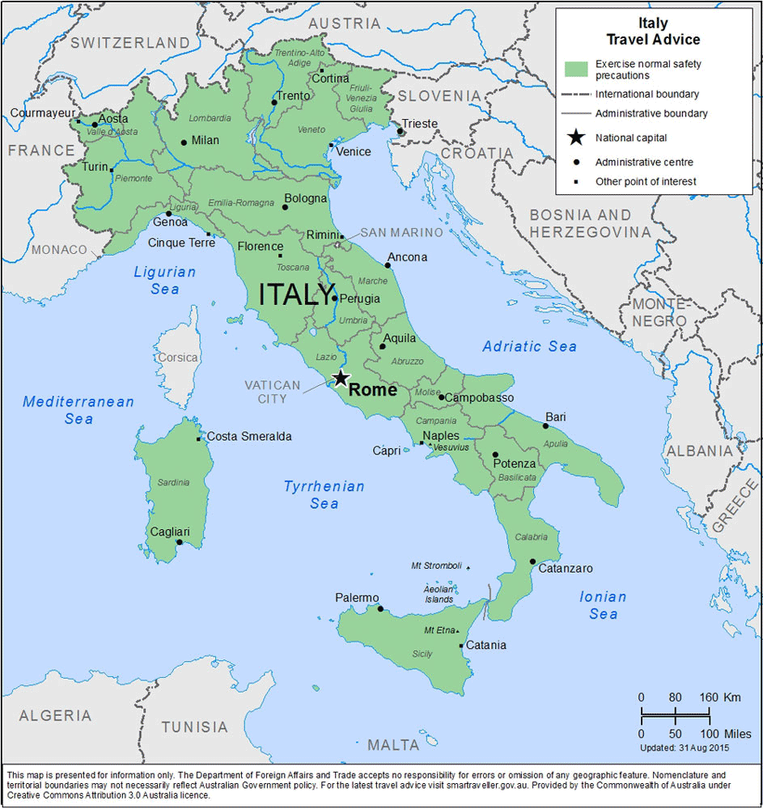
We need :
A GUI programming framework (tkinter)
A widget for drawing (Canvas)
A method to draw polygons

Slide 10


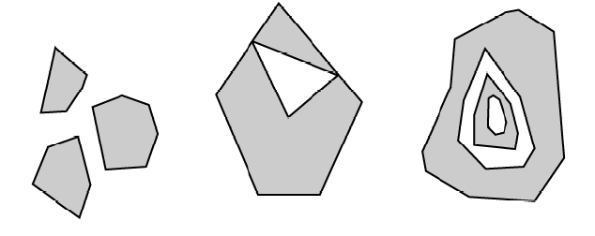
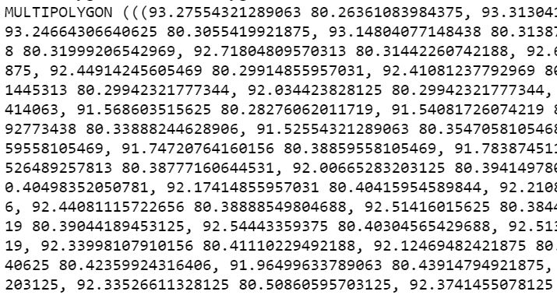
Polygons
Shapefile (.shp)
Multipolygons

Slide 11
Shapes extraction
shapefile module
(pyshp)
Shapefile (.shp)

Slide 12
Extract the polygons of a multipolygon
shapely module
Polygons and multipolygons
Polygons only

Slide 13
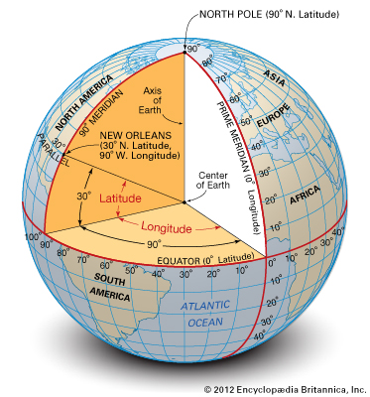
Point on the earth
(longitude, latitude)

Slide 14
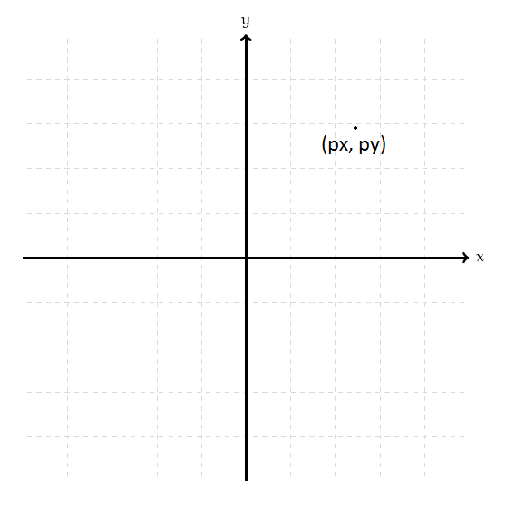
Point on the earth (3D) (longitude, latitude)
Point on a plan (2D)
(projected x, projected y)

Slide 15
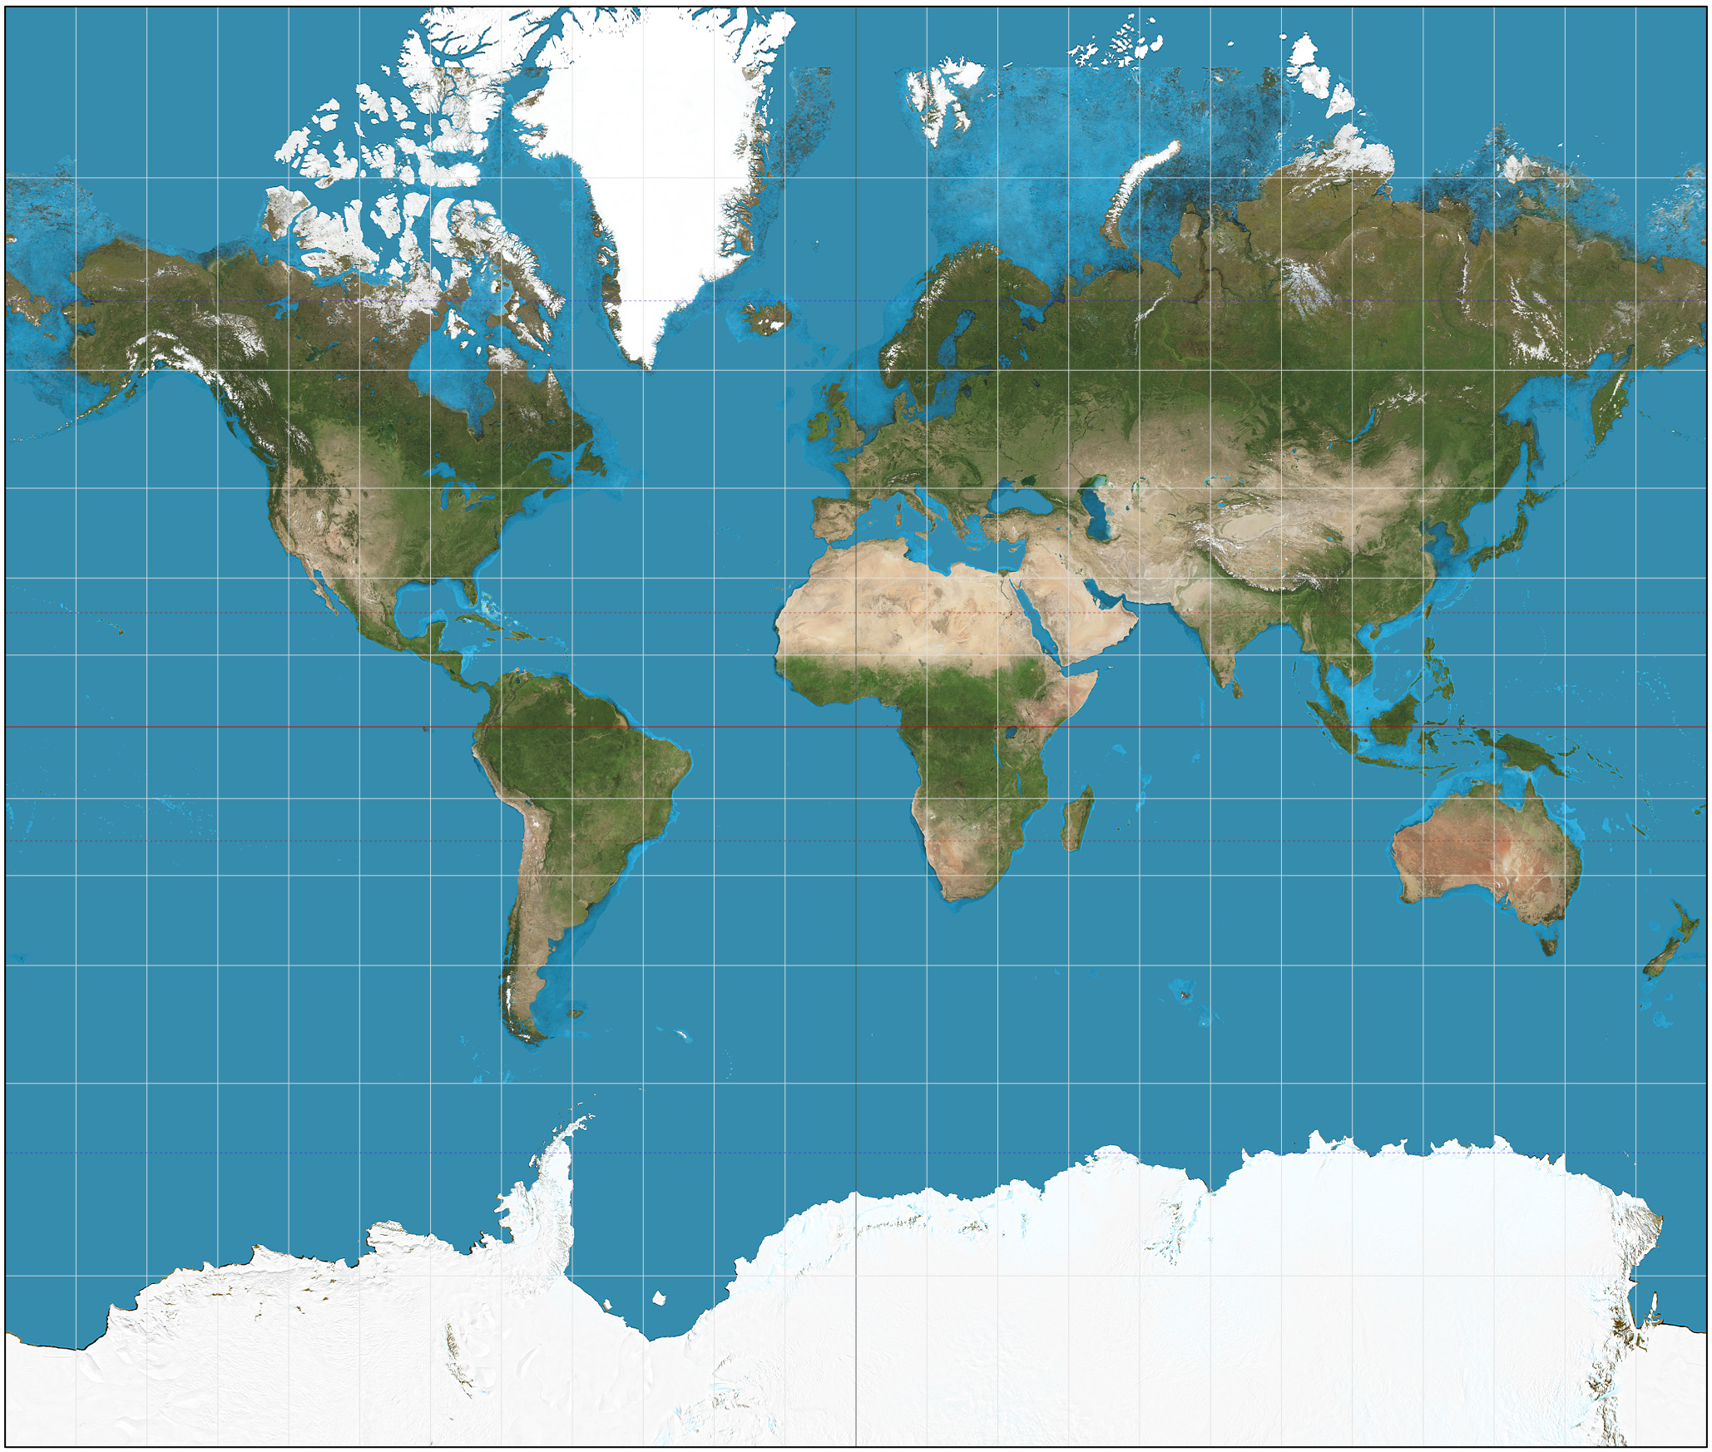

Convert geographic coordinates into projected coordinates :
pyproj
Mercator
Azimuthal orthographic

Slide 16
We need :
A GUI programming toolkit (tkinter)
A widget to create polygons (tkinter’s Canvas)
A file that contains the map coordinates (shapefile)
A library to read shapefiles (pyshp)
A library to convert multipolygons into polygons (shapely)
A library to convert geographic coordinates into projected coordinates (pyproj)

Slide 17
Netmiko
SSH/Telnet
Paramiko
Exscript
NETCONF/YANG (multi-vendor, IETF)
Network programmability using YANG / NETCONF
OSS protocols: TL1, SNMP (pySNMP)
Puppet, Chef, Saltstack, HPNA
Configuration management tools
Ansible
Vendor-specific solution

Slide 18
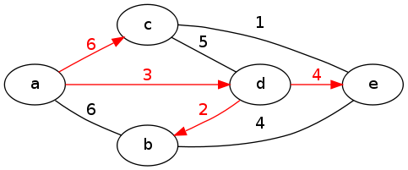
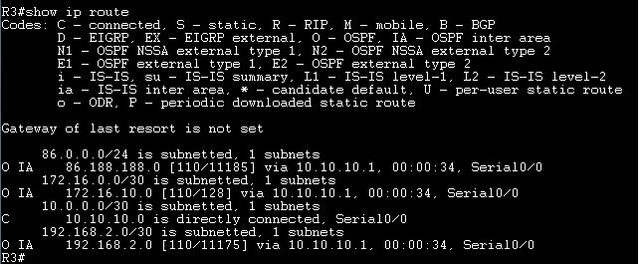
A router…
Run Dijkstra’s algorithm to find the Shortest Path Tree
Create the routing table: (destination outgoing interface)
(applies to link state protocols like OSPF and IS-IS)

Slide 19
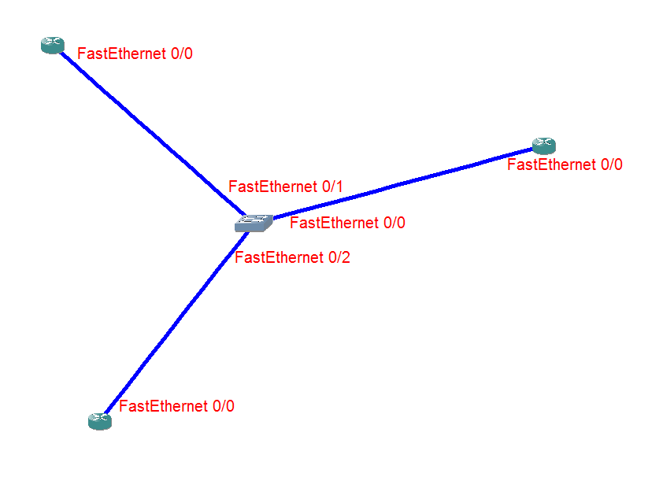
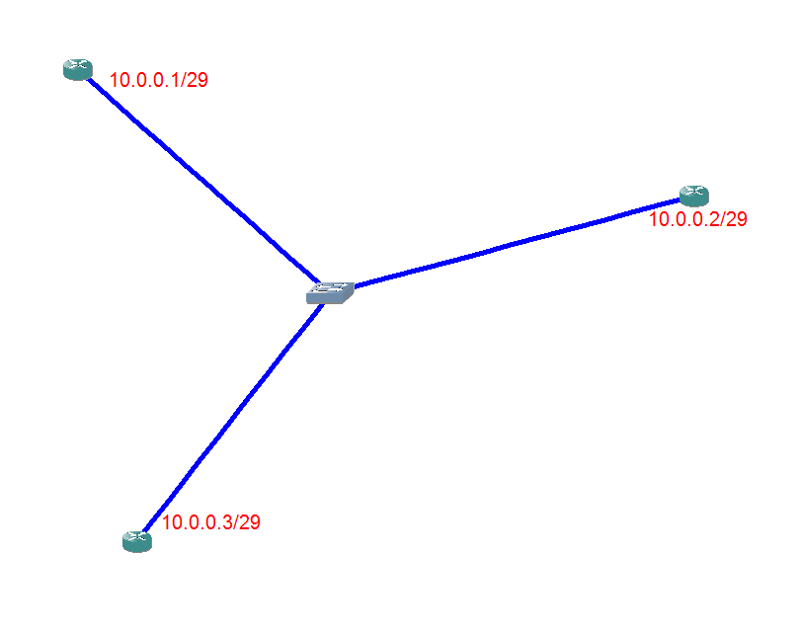
Allocate names to all interfaces
Allocate IP addresses to all interfaces
Choose a protocol (RIP, OSPF, IS-IS, …)
1
2

Slide 20
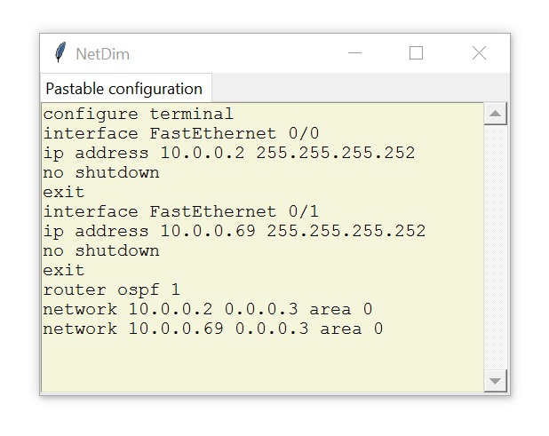
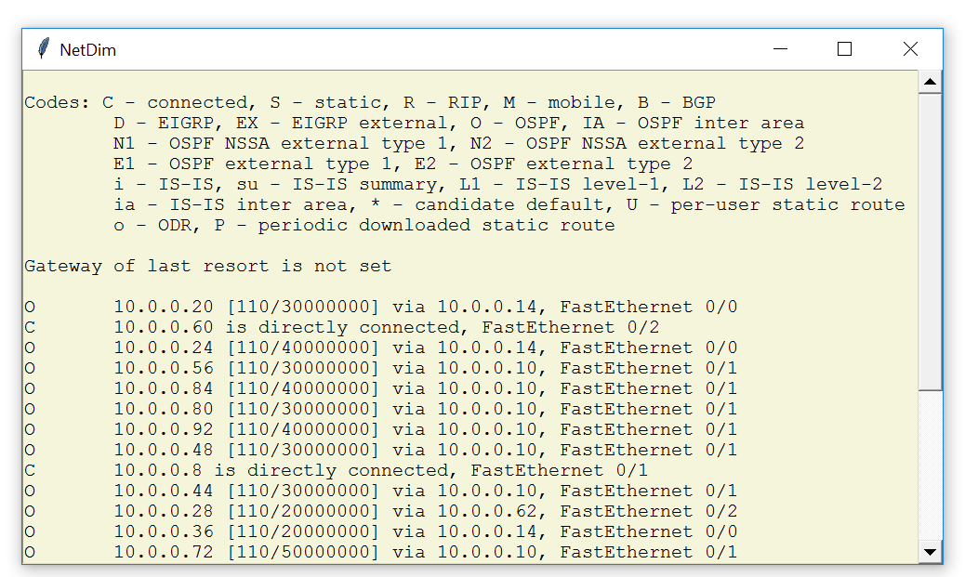
Generate the configuration
Create of the routing tables
4
5

Slide 21
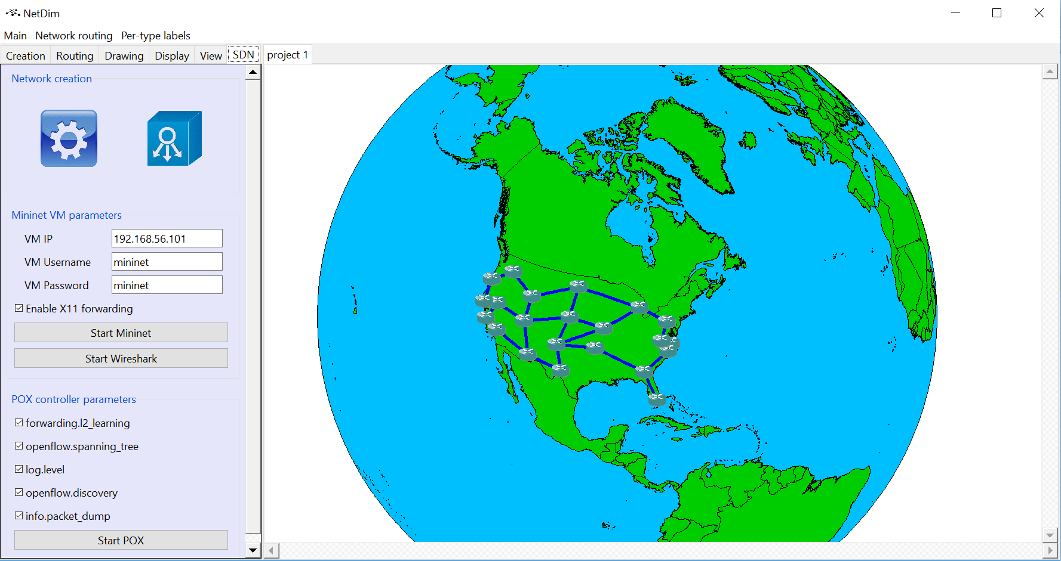
pyNMS
https://github.com/afourmy/pyNMS
Open-source (GPLv3)
Vendor-agnostic
Tkinter-based GUI (possible switch to PyQT)
No stable release yet (some bug fixing needed)

Slide 22
Force-based algorithms
Visualization
Map drawing
Routing
Automatic configuration generation
Simulation
Capacity planning
Failure simulation
Automation
Emulation (Mininet, pox)
Linear programming (cvxopt)
Optimization
Metaheuristics

Slide 23
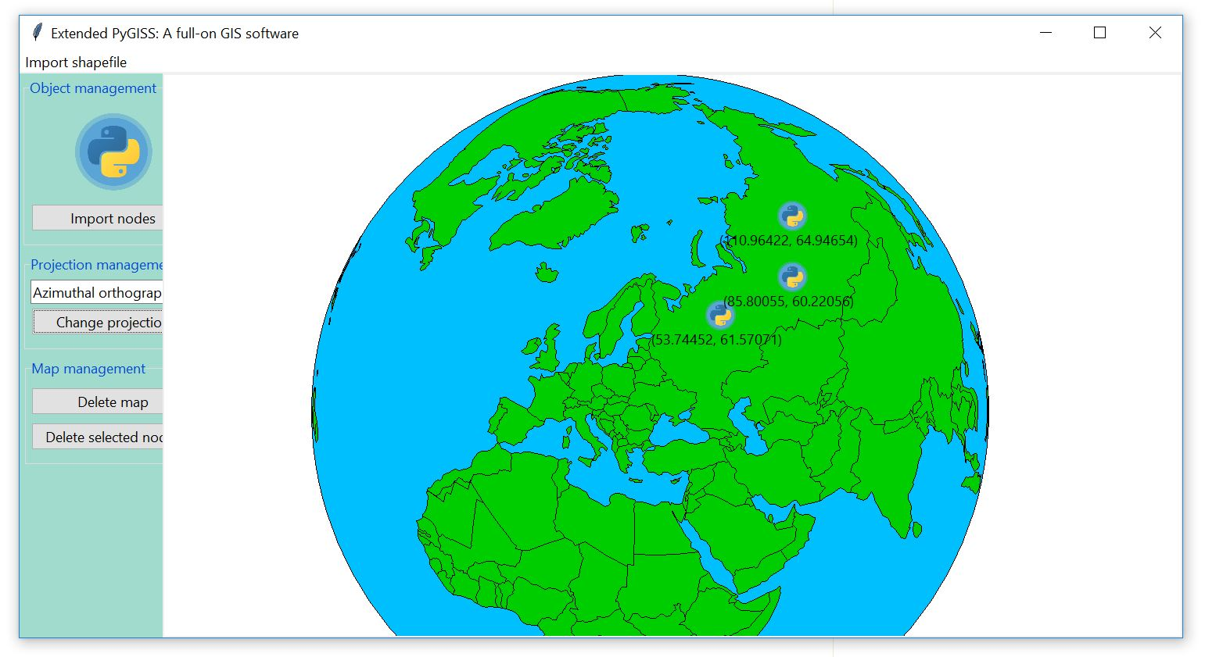
pyNMS
pyGISS (MIT)
https://github.com/afourmy/pyGISS

Slide 24
https://github.com/afourmy/pyNMS
https://github.com/afourmy/pyGISS
https://github.com/afourmy/EuroPython-2017
https://github.com/Toblerity/Shapely
https://github.com/jswhit/pyproj
https://github.com/knipknap/exscript
https://github.com/ktbyers/netmiko
https://github.com/ansible/ansible
Thank you

